Slide 1
Turn in your worksheet, copy Target, Math Goal, Date and this table. Answer the question in complete sentences, restating the question at the beginning of your sentence.
Is this a proportional relationship? If it is proportional, what is the constant unit rate?
If you graphed this relationship, what would the point (0,0) represent in this situation?
If there is a unit rate, where would it be located if the data was graphed (give a point)?
What would the point (16, 88) represent in this situation?
Time (minutes) | Distance Traveled by a SNAIL (cm)
2 | 11
5 | 27.5
12 | 66
15 | 82.5

Slide 3
Meet “k”
Constant of Proportionality

Slide 4
CONSTANT OF PROPORTIONALITY = Unit RATE!
K=$\frac{y}{x}$

Slide 5
Constant of Proportionality = k
Definition
Ratio between 2 values that is the same
Constant Unit Rate
k=$\frac{y}{x}$
Characteristics
Written as a ratio (fraction) or decimal
Sometimes units are unwritten
Constant (ALWAYS THE SAME)
Constant of Proportionality
Examples
12 miles per hour (k=12)
2 out of 5 people surveyed love the Beb (k = $\frac{2}{5}$ )
K = $\frac{30}{1}$ means $30 per hour
Non-Examples
When a relationship is NOT
Proportional, there is NO k!!!!!
$12 1st hour; $43 2nd hour

Slide 6
Bieber Fever
Total | Love Beb
200 | 60
250 | 75
400 | 120
550 | 165
Is the relationship proportional?
What is the “k”?
What point (x, y) on a graph represents “k”?
What does the constant of proportionality represent in this relationship?
Yes, there is a constant unit rate.
K = 0.3 or $\frac{3}{10}$
(1, 0.3) or (1, $\frac{3}{10}$)
3 out of 10 people asked love Justin Bieber.

Slide 7
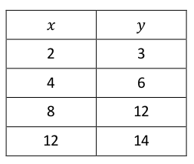
Miles Walked
Is the relationship proportional?
What is the “k”?
What point (x, y) on a graph represents “k”?
What does the constant of proportionality represent in this relationship?
hours
miles
The relationship is not proportional, because there is not a constant rate. There is no “k” because the relationship is not proportional.

Slide 8
What does it all mean?
What is “k”?
What point on the graph shows “k”?
What does the constant of proportionality represent?
k = 3
(1, 3)
The speed of 3 miles in 1 hour.

Slide 9
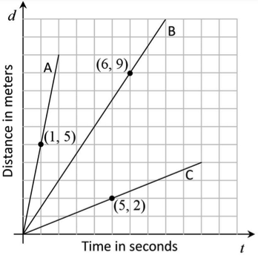
Who is the fastest?
What is “k”?
What point on the graph shows “k”?
What does the constant of proportionality represent?
A: k = 5; B: k = 1.5; C: k = 0.4
A: (1, 5); B: (1, 1.5); C: (1, 0.4)
The Speed. A: 5 meters in 1 hour;
B: 1.5 meters in 1 hour; C: 0.4 meters in 1 hour.

