Slide 1
An introduction to tree diagrams (level 7-8)
LO:-
Must be able to calculate probability of an event happening and not happening.
Should be able to draw a tree diagram.
Could be able to calculate probabilities from a tree diagram.

Slide 2
Example question.
Sam has a bag.
In this bag be puts
6 blue balls and 4 red
balls.
What is the probability of getting a red ball?
P( red) = 4/10

Slide 3
OUTCOMES
Sam picks one ball and records the colour and puts it back. He then picks a second ball and records the colour. What are all the possible outcomes?
First pick | Second pick

Slide 4
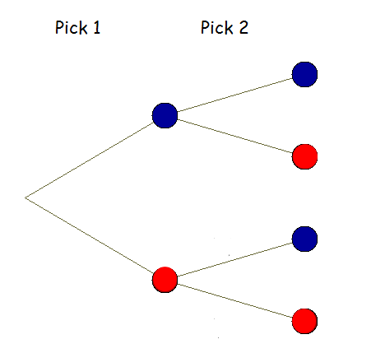
Tree diagram

Slide 5
Now try this Question
Find P(red)=
P(green) =
Now draw a tree diagram

